Slide 1
Course 3 : IP ROUTING
Berrehouma N.

Slide 2
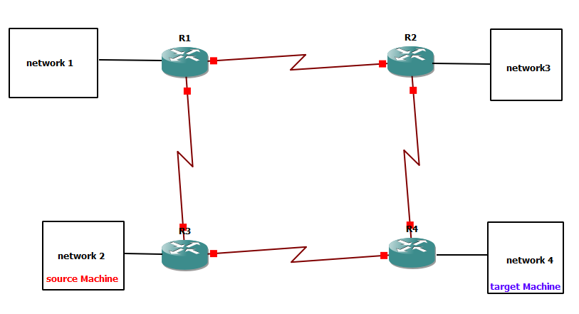
IP routing is the process that defines the shortest path through which data travels to reach from source to destination in different networks.
IP routing is done by Routers

Slide 3
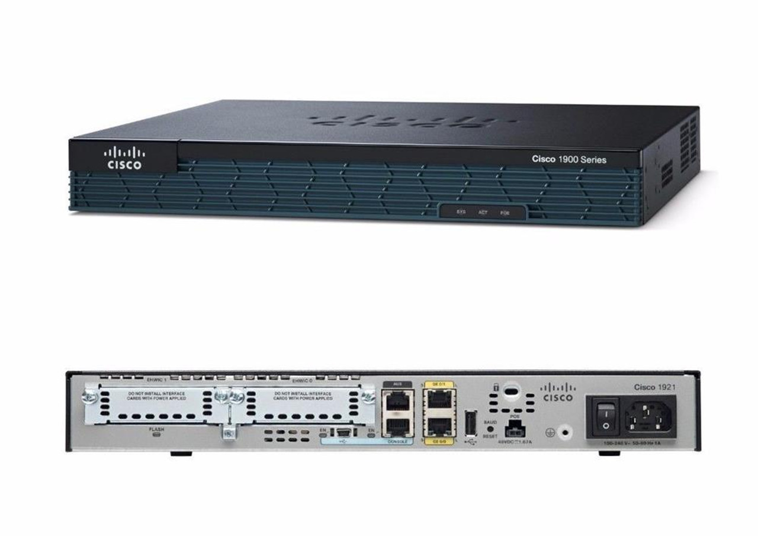
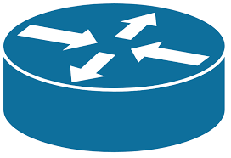
What is a Router ?
A Router is a networking device that forwards data packets between computer network.
Usually connected to two or more different networks.

Slide 4

Some CISCO Routers

Slide 5
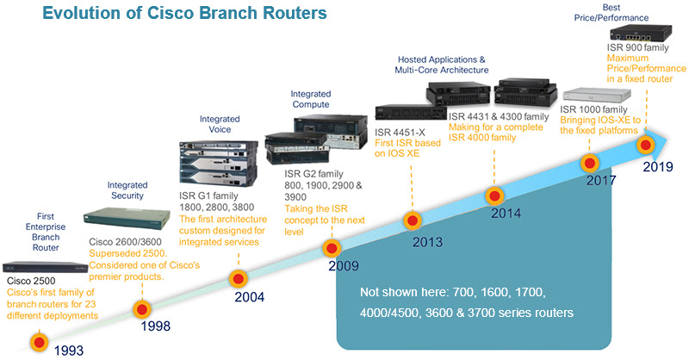

Slide 6
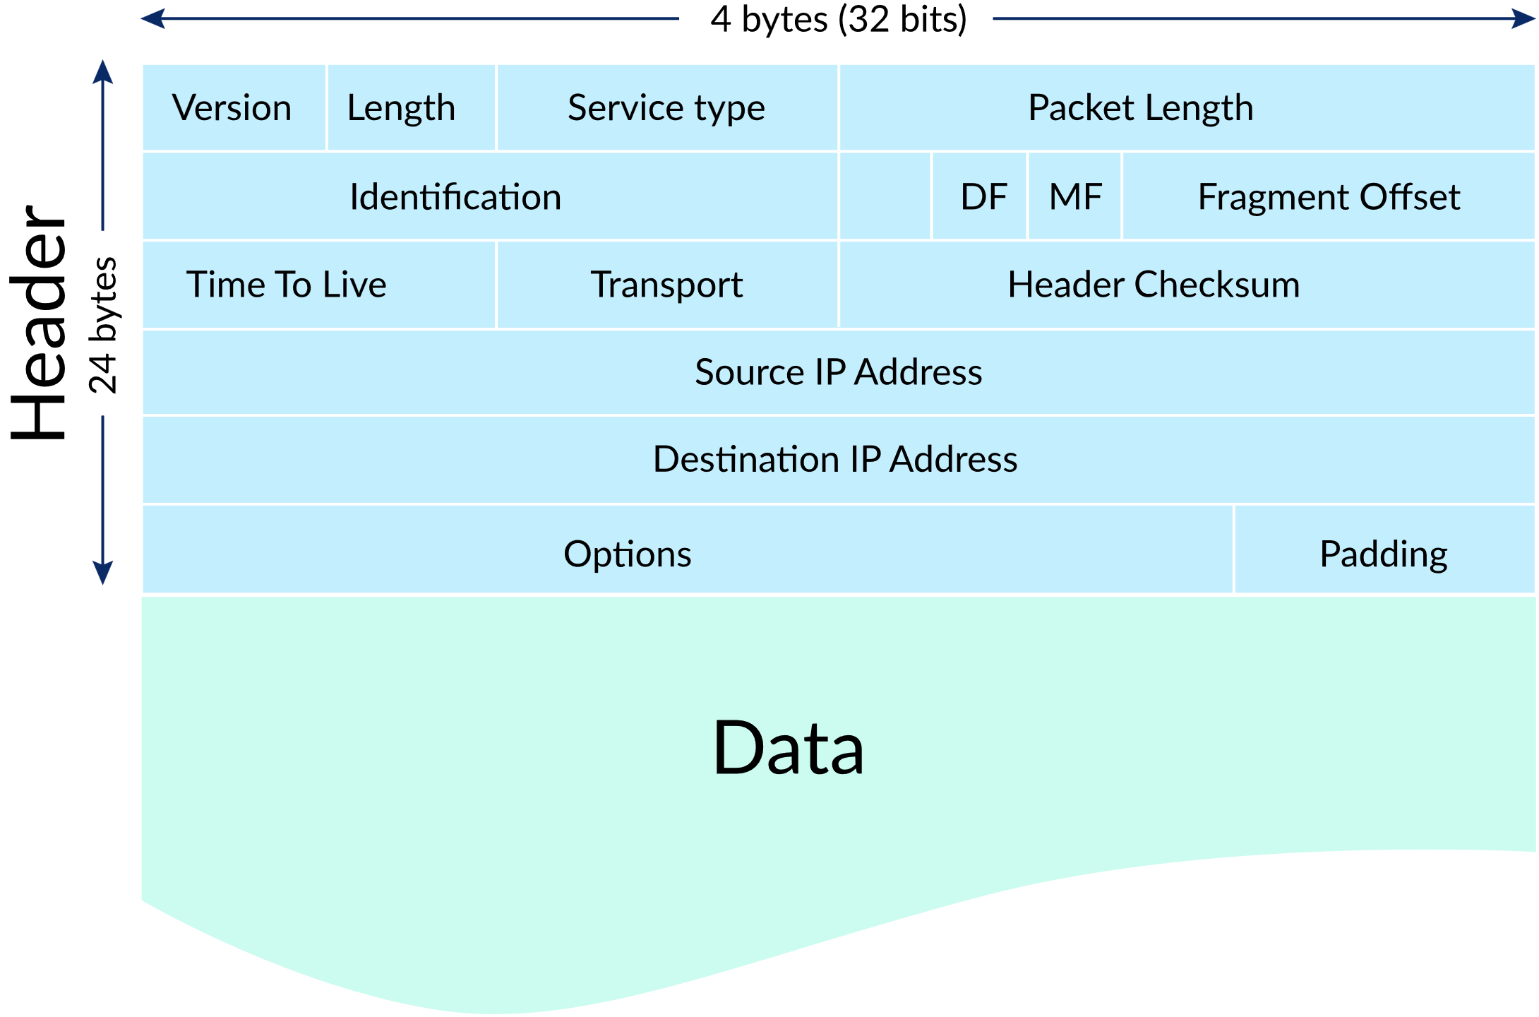
Routing Table
Located in the router (RAM memory) and stores the routing information.
When a packet arrives. The Router examines destination IP address of a received packet and make routing decisions accordingly.
Routers use Routing Tables to determine out which interface the packet will be sent.
A routing table lists all networks for which routes are known.
Destination Subnet mask Interface
128.75.43.0 255.255.255.0 Eth0
128.75.43.0 255.255.255.128 Eth1
192.12.17.5 255.255.255.255 Eth3
default Eth2
Example of a routing table

Slide 7
Entries of an IP Routing Table
Each entry in the routing table consists of the following entries :
Network ID: The network ID or destination corresponding to the route.
Subnet Mask: The mask that is used to match a destination IP address to the network ID.
Next Hop: The IP address to which the packet is forwarded
Outgoing Interface: Outgoing interface the packet should go out to reach the destination network.
Metric: A common use of the metric is to indicate the minimum number of hops (routers crossed) to the network ID.

Slide 8
How does IP routing work?
The router gets the destination address from the IP packet.
Through its routing table identifies the next router information to which the data packet has to be passed.
Different packets can be sent through different paths but all the packets reach their intended destination.

Slide 9
Different Types of Routing
There are three different types of routing:
Static Routing : The routing table is updated by the network administrator.
Dynamic Routing : The routing table is automatically updated using routing protocols.
Default Routing : The router is configured to send all the data towards a specific router.

Slide 10
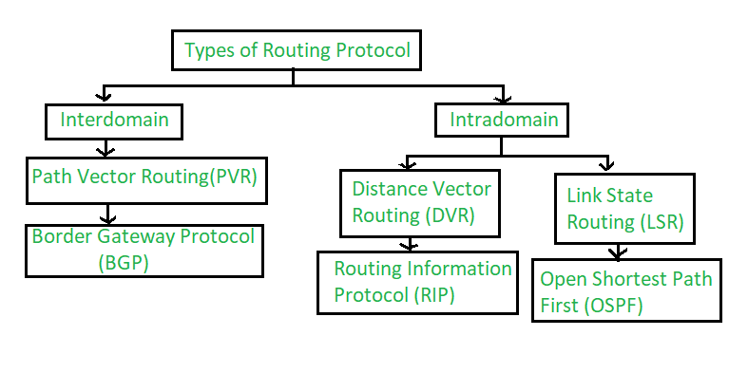
Routing Protocols
For taking routing decisions router needs various routing protocols and a routing table. The routing protocols are divided into two domains
Interdomain Routing protocols
Intradomain Routing protocols

Slide 11
Distance Vector Routing
Distance vector routing uses distance vectors for routing.
It uses the Bellman-Ford algorithm for the computation of various distances.
Routing Information Protocol(RIP) is used in DVR for making routing decisions.
DVR suffers from count to infinity problem which can be solved using split-horizon or route poisoning.

Slide 12
Link State Routing
Link State routing uses the state of the link for routing.
It uses the Dijkstra algorithm for the computation of various distances.
Open Shortest Path First(OSPF) is used in LSR for making routing decisions.
LSR suffers from heavy traffic due to flooding.

Slide 13
RIP (Routing Information Protocol)
RIP is a standardized Distance Vector protocol
The network is a graph where nodes are the routers, and the edges are the links between them.
Designed for use on smaller networks.
The cost metric is the number of hops to reach the destination.
In RIP, infinity is defined as 16

Slide 14
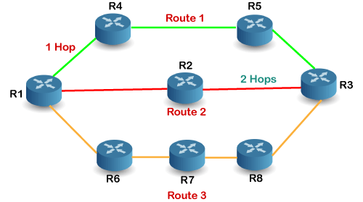
How does the RIP work?
there are 8 routers in a network where Router 1 wants to send the data to Router 3.
There are three routes in the above network.
The Route 2 contains the least number of hops
so RIP will choose Route 2.

Slide 15
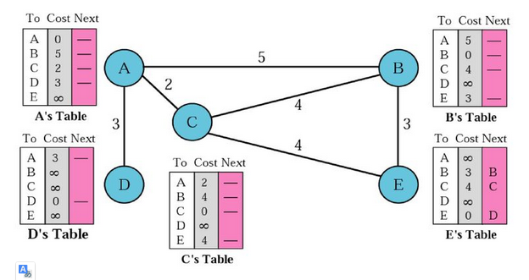
RIP initialization
At the beginning, each node can know only the distance between itself and its immediate neighbors, those directly connected to it

Slide 16
RIP : Sharing
The whole idea of distance vector routing is the sharing of information between neighbors
A node A does not know about node E, node C does.
So if node C shares its routing table with A, node A can also know how to reach node E
Note: In distance vector routing, each node shares its routing table with its immediate neighbors periodically and when there is a change.

Slide 17
RIP : Updating
When a node receives a 2-column table from a neighbor,
it needs to update its routing table.
Updating takes 3 steps:
The receiving node needs to add the cost between itself and the sending node to each value in the second column
The receiving node needs to add the name of the sending node to each row as the 3rd column if the receiving node uses information from any row. The sending node is the next node in the route

Slide 18
RIP : Updating (Continue)
The receiving node needs to compare each row of its old table with the corresponding row of the modified version of the received table.
If the next-node entry is different, the receiving node chooses the row with the smaller cost.
If there is a tie, the old one is kept If the next-node entry is the same, the receiving node chooses the new row. For example, if node C has previously advertised a route to node X with distance 3. Suppose that now there is no path between C and X; node C now advertises this route with a distance of infinity. Node A must not ignore this value even though its old entry is smaller.

Slide 19
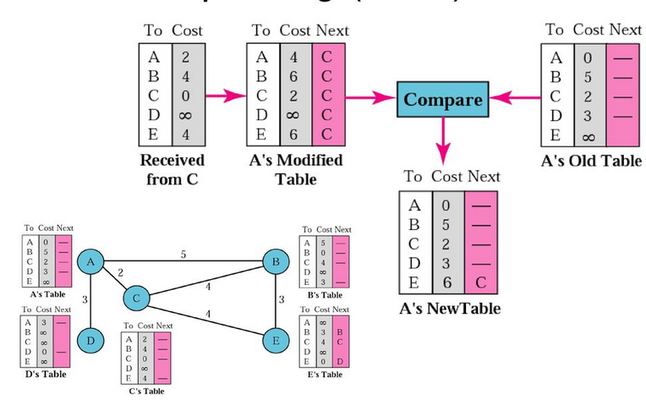
RIP : Updating (Continue)

Slide 20
When to Share ?
Periodic Update. A node sends its routing table, normally every 30 seconds, in a periodic update. The period depends on the protocol that is using distance vector routing
Triggered Update. A node sends its 2-column routing table to its neighbors any time there is a change in its routing table.
The change can result from the following.
A node receive a table from a neighbor resulting in changes in its own table after updating
A node detects some failure in the neighboring links which results in a distance change to infinity

Slide 21
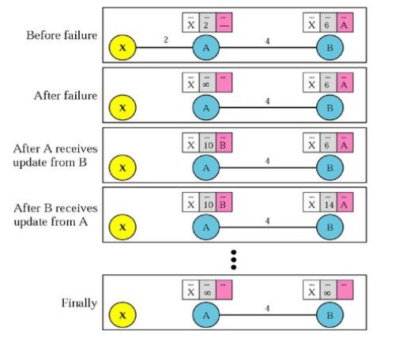
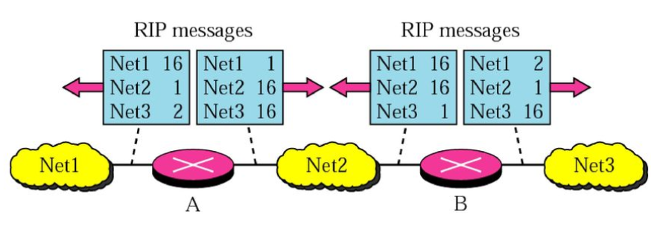
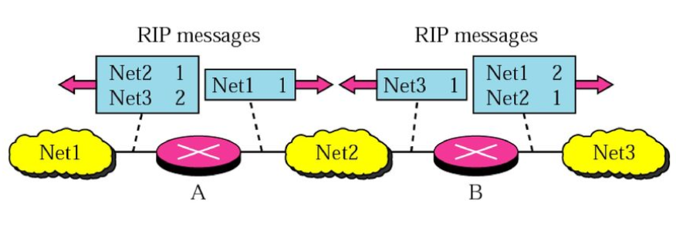
Two-Node Loop Instability
Solutions
Defining Infinity. Most implementation of the distance vector protocol define the distance between each node to be 1 and define 16 as infinity. Therefore, the distance vector cannot be used in large systems
Split Horizon. In this strategy, instead of flooding the table through each interface, each node sends only part of its table through each interface. If node B thinks that the optimum route to reach X is via A, it does not need to advertise this piece of information to A.
Split Horizon and Poison Reverse. This strategy is a combination between split horizon and poison reverse where node B can still advertise the value of X, but if the source of information is A, it can replace the distance with infinity as a warning: “Don’t use this value; what I know about this route comes from you.”

Slide 22
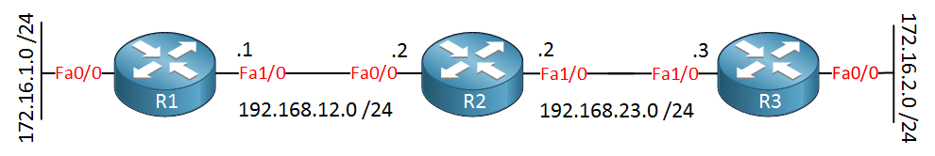
Practical Work
Configure the routing table both static and dynamic (RIP) methods for R1 , R2 and R3

Slide 23
Practical Work : Configuring static routes on Cisco Router
 | Command | Purpose
Step 1 | configure terminal Example: r1# configure terminal r1(config)# | Enters configuration mode.
Step 2 | ip route {ip-prefix | ip-addr ip-mask} {[next-hop | nh-prefix] | [interface next-hop | nh-prefix]} [tag tag-value [pref] Example: r1(config)# ip route 192.0.2.0/8 ethernet 1/2 192.0.2.4 | Configures a static route and the interface for this static route. You can optionally configure the next-hop address. The preference value sets the administrative distance. The range is from 1 to 255. The default is 1.
Step 3 | show ip static-route Example: r1(config)# show ip static-route | (Optional) Displays information about static routes.
Step 4 | copy running-config startup-config Example: r1(config)# copy running-config startup-config | (Optional) Saves this config

Slide 24
Practical Work : Configuring Dynamic routes on Cisco Router using RIP protocol
R1>enable
R1#configure terminal
R1(config)#interface fastEthernet 0/0
R1(config-if)#no shutdown
R1(config-if)#ip address 172.16.1.1 255.255.255.0
R1(config-if)#exit
R1(config)#interface fastEthernet 1/0
R1(config-if)#ip address 192.168.12.1 255.255.255.0
R1(config-if)#no shutdown
R2>enable
R2#configure terminal
R2(config)#interface fastEthernet 0/0
R2(config-if)#no shutdown
R2(config-if)#ip address 192.168.12.2 255.255.255.0
R2(config-if)#exit
R2(config)#interface FastEthernet 1/0
R2(config-if)#no shutdown
R2(config-if)#ip address 192.168.23.2 255.255.255.0
R2(config-if)#exit
R3>enable
R3#configure terminal
R3(config)#interface fastEthernet 0/0
R3(config-if)#no shutdown
R3(config-if)#ip address 172.16.2.3 255.255.255.0
R3(config-if)#exit
R3(config)#interface fastEthernet 1/0
R3(config-if)#no shutdown
R3(config-if)#ip address 192.168.23.3 255.255.255.0
R3(config-if)#exit
R1#show ip route
Codes: C - connected, S - static, R - RIP, M - mobile, B - BGP
D - EIGRP, EX - EIGRP external, O - OSPF, IA - OSPF inter area
N1 - OSPF NSSA external type 1, N2 - OSPF NSSA external type 2
E1 - OSPF external type 1, E2 - OSPF external type 2
i - IS-IS, su - IS-IS summary, L1 - IS-IS level-1, L2 - S-IS level-2
ia - IS-IS inter area, * - candidate default,
o - ODR, P - periodic downloaded static route
Gateway of last resort is not set
C 192.168.12.0/24 is directly connected, FastEthernet1/0
172.16.0.0/24 is subnetted, 1 subnets
C 172.16.1.0 is directly connected, FastEthernet0/0
R2#show ip route
Codes: C - connected, S - static, R - RIP, M - mobile, B - BGP
D - EIGRP, EX - EIGRP external, O - OSPF, IA - OSPF inter area
N1 - OSPF NSSA external type 1, N2 - OSPF NSSA external type 2
E1 - OSPF external type 1, E2 - OSPF external type 2
i - IS-IS, su - IS-IS summary, L1 - IS-IS level-1, L2 - S-IS level-2
ia - IS-IS inter area, * - candidate default,
o - ODR, P - periodic downloaded static route
Gateway of last resort is not set
C 192.168.12.0/24 is directly connected, FastEthernet0/0
C 192.168.23.0/24 is directly connected, FastEthernet1/0
R3#show ip route
Codes: C - connected, S - static, R - RIP, M - mobile, B - BGP
D - EIGRP, EX - EIGRP external, O - OSPF, IA - OSPF inter area
N1 - OSPF NSSA external type 1, N2 - OSPF NSSA external type 2
E1 - OSPF external type 1, E2 - OSPF external type 2
i - IS-IS, su - IS-IS summary, L1 - IS-IS level-1, L2 - S-IS level-2
ia - IS-IS inter area, * - candidate default,
o - ODR, P - periodic downloaded static route
Gateway of last resort is not set
172.16.0.0/24 is subnetted, 1 subnets
C 172.16.2.0 is directly connected, FastEthernet0/0
C 192.168.23.0/24 is directly connected, FastEthernet1/0
R1(config)#router rip
R1(config-router)#network 192.168.12.0
R1(config-router)#network 172.16.1.0
R2(config)#router rip
R2(config-router)#network 192.168.12.0
R3(config)#router rip
R3(config-router)#......

Slide 25
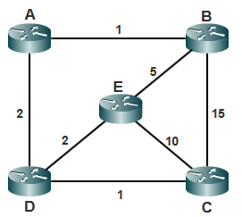
Tutorial Work
On considère le réseau (le coût des liens est indiqué) et on suppose qu’à l’initialisation, chaque nœud connaît le coût vers chacun de ses voisins. L'algorithme utilisé par le protocole de routage est de type vecteur à distance.
Donner les tables de routage initiales des différents routeurs du réseau.
Les routeurs B et D viennent de recevoir le vecteur de distance de A. Donner les nouvelles tables de routage des routeurs B et D ?
Donner l’évolution des tables de routage des routeurs C et E jusqu’à la convergence.

Slide 26
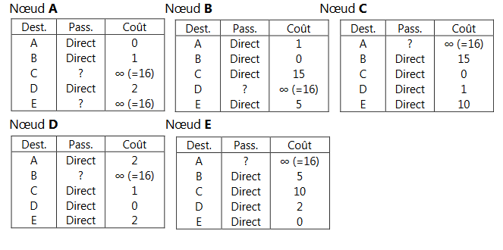
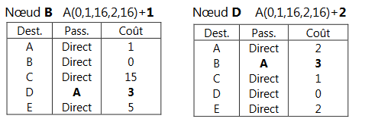
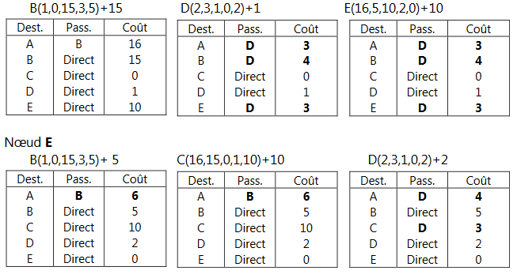
Les tables de routage initiales des différents nœuds
Les tables de routage des nœuds B et D après recaption du tableau du A
Les tables de finales de C et E

Slide 27
